Slide 1
HOUSE_PRICE_ PREDICTION

Slide 2

HOUSE_PRICE_PREDICTION
Submitted to the Savitribai Phule Pune University, Pune in the partial fulfillment for the award of the degree of bachelor of engineering in computer engineering
Under the guidance of
Prof.S.S.Nimbalkar
Department of computer engineering svpm's college of engineering Malegaon(bk) a/p-malegaon(bk)-413115, tal. Baramati, dist. Pune

Slide 3
TABLE OF CONTENTS
04 Output
01 Introduction
05 Conclusion
02 Problem Statement
03 Proposed Architecture
06 References

Slide 4
INTRODUCTION
. - It is imperative to find the correct price for a housing residence if anyone is planning to shift to a particular locality in a city with different brokers quoting different prices for similar houses in the same locality in a particular city.
- This project aims to reduce the burden of the common man who intends to find the probable range of prices for housing residences for a given parameters with minimal error.
This project will encourage all the stake-holders in the real estate sector like brokers and the buyers as well as sellers to be more realistic when quoting housing prices and will give a base for understanding the market regarding the same.

Slide 5
PROBLEM STATMENT
The goal of this statistical analysis is to help us understand the relationship between house features and how these variables are used to predict house price.

Slide 6
- We have used HTML, CSS and Javascript for frontend. For Backend part, we have used Node.js and MongoDB.
- For editing the static pages we have used express which will make the pages dynamic.
- We have used MongoDB because it is a NOSQL database and data retrieval is faster.
- We have connected ML Model, MongoDB Database and run them with the help of Node.js.
- We run the Linear Regression from within a child process which is spawned from Node.js and runs python scripts and returns JSON files for the particular input given which are passed on to the frontend for viewing purpose.

Slide 7
Proposed Architecture
Front End
User enters parameters in a form
Server parses the JSON into an HTML Document and returns to the front end
Server with MongoDB
Server runs a child process
JSON file is returned with the trained model
Python kernel running the ML algorithms
Data is fetched from the database and appropriate Model is trained

Slide 8
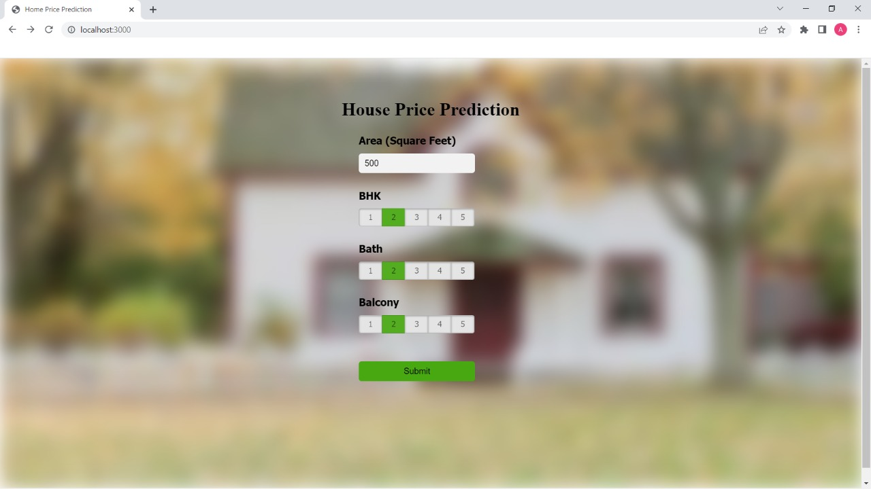
Input Page

Slide 9
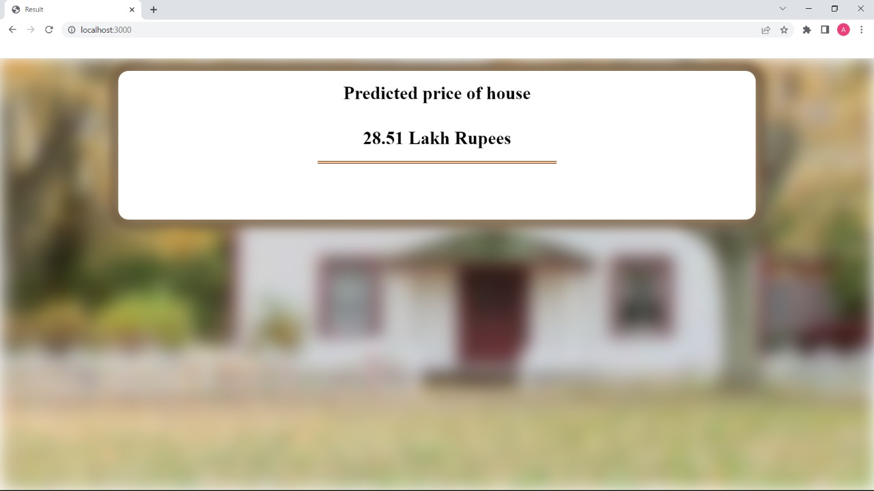
Output Page

Slide 10
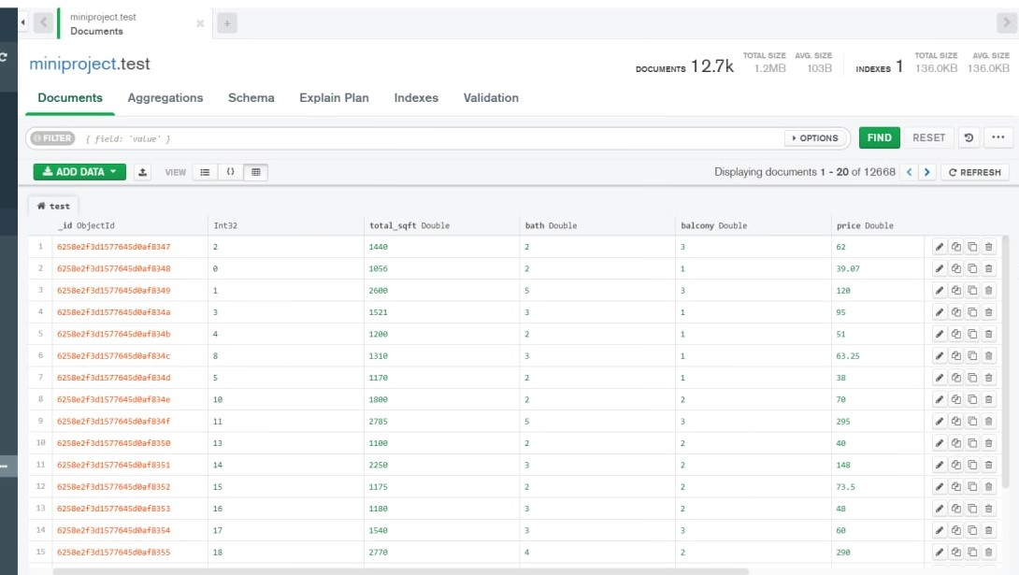
Dataset

Slide 11
Conclusion
- This project helped us understand the CRUD operations behind any database
-This project helped us to understand how to work in MongoDB and to connect MongoDB with Node.js using mongoose library.
- This project also helped us to understand linear regression in Machine Learning.

Slide 12
References
-GeeksForGeeks for Pymongo library..
-TutorialsPoint for basic MongoDB operations.
-GeeksforGeeks for Linear Regression.•
-Towards Data Science.com for data manipulation using Pandas library
-MongoDB official documentation for predictive data models in MongoDB.

Slide 13
THANK YOU

